Slide 1


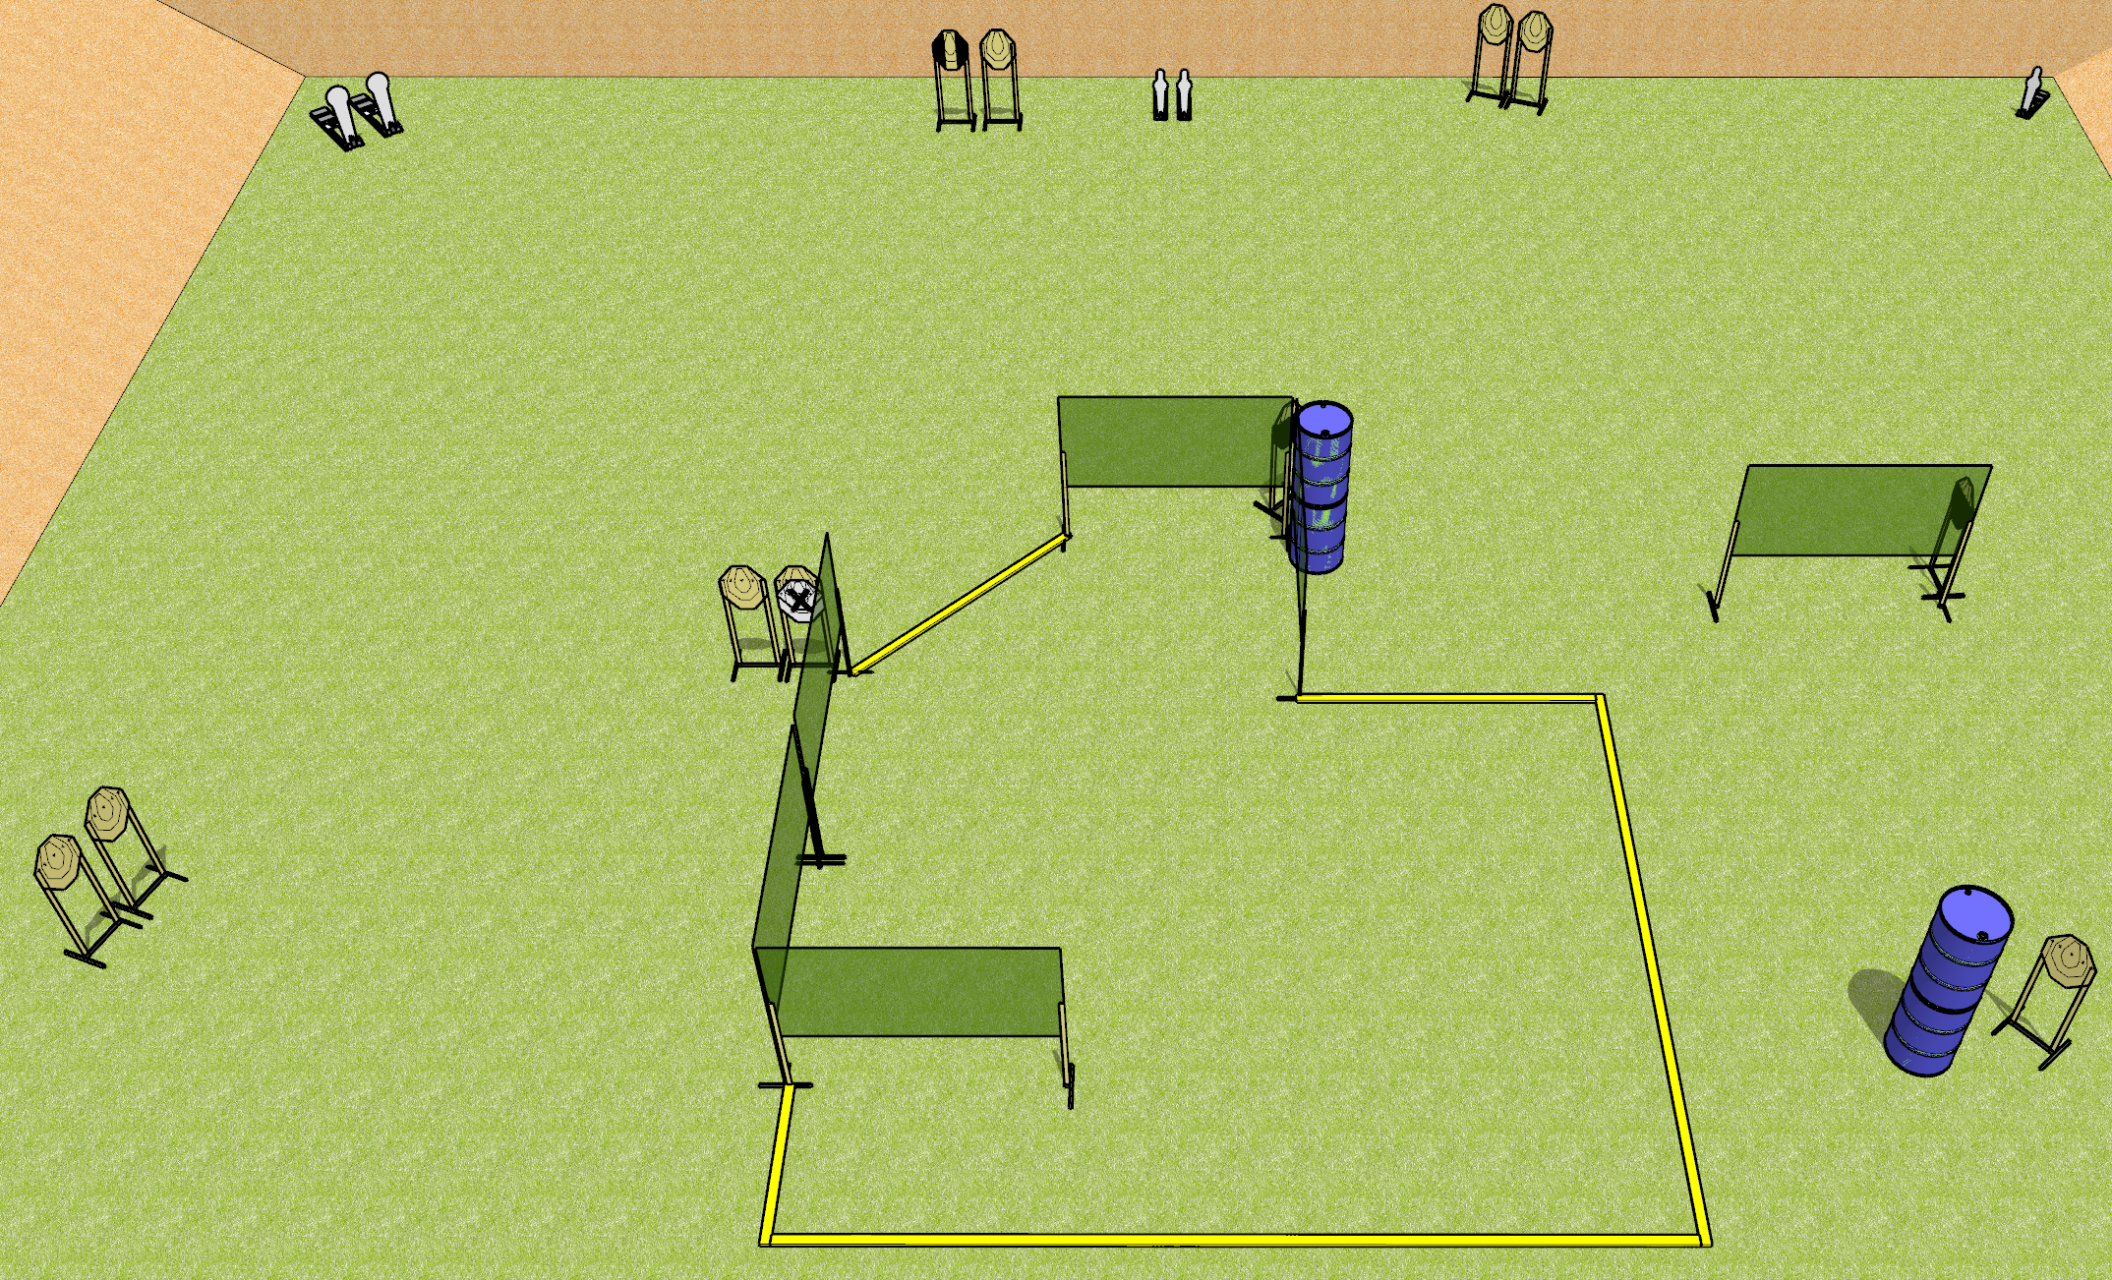
 | Dothan Gun Club – USPSA Match Turtle Season Course Designer : Drew Coleman
Round Count 29 rounds 2 colt poppers, 3 mini poppers 12 IPSC
Equipment List 9 wall feet 1 medium fault line 1 tuxedo, 2 50%

Slide 2
Turtle Season
Written Stage Briefing
Turtle Season is a 29 round, 145 point, Comstock course of fire. There are 12 IPSC targets, 2 colt poppers, and 3 mini poppers. The best 2 hits on paper will score, and steel must fall to score. The start signal is audible.
Handgun start position is anywhere inside the shooting area, wrists below belt. Handgun is loaded and holstered.
PCC start position is anywhere inside the shooting area, stock on belt. Loaded carbine is held with both hands, safety on.
On start signal, engage targets as they become available from within the shooting area.

